Slide 1


Optimization Methods for Track Fitting in the AT-TPC
Christina Chen
Davidson College
11/29/2018

Slide 2

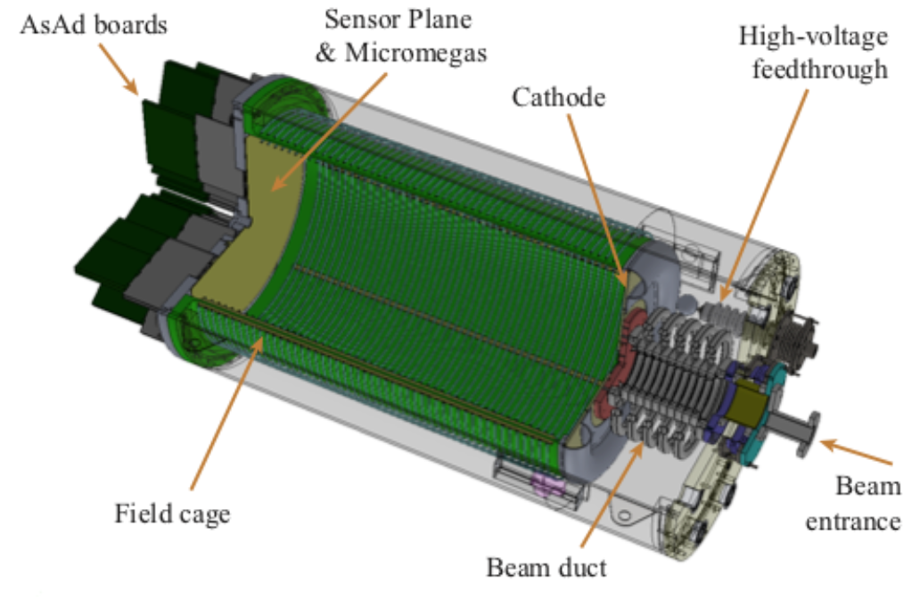
The Active-Target Time Projection Chamber (AT-TPC)
Gas-filled
Pad plane consists of 10240 pads
Gas serves as both the target and the detector
High efficiency, high resolution
Layout of the
pad plane
Image: Joshua Bradt (NSCL)
Notes:
active volume,
surrounded by magnetic field generated by a solenoid
an uniform electric field
pad plane receives charge signals as particle travels through the active volume; the large number of pads increases the spatial resolution of the detector

Slide 3
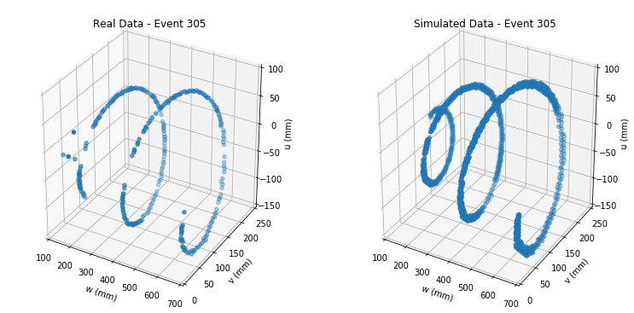
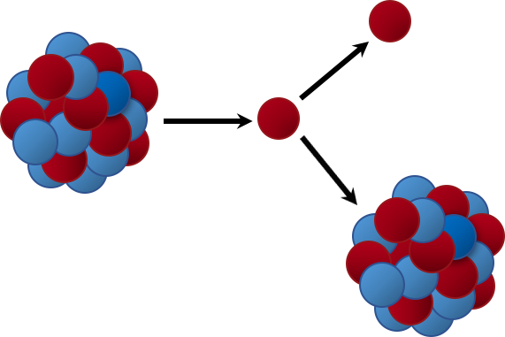
Proton – ⁴⁶Ar Elastic Scattering Experiment
Why do we study rare isotopes?
Intermediate product is unstable
Product of decay: proton
Contracting spiral tracks are due to the Lorentz Force and energy loss (Bethe Formula)
Track fitting algorithm finds kinematics properties of proton
⁴⁶Ar(p,p) reaction
Image: Jack Taylor ‘18
Notes:
We want to explore the physical properties of exotic nuclei by understanding the nuclear shell structures of them.
Here is a plot of the spiral track. It’s spiral with decreased radius because of the Lorentz force (charged particle in an electric and magnetic field), and the energy loss described by the Bethe formula
Using the track fitting algorithm we are able to extract the kinematic properties of the proton that can eventually help us understand the physics of the Argon isotope.

Slide 4
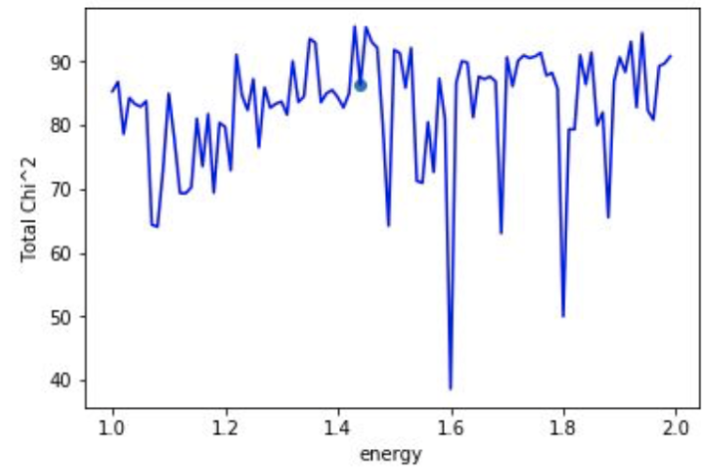
Global Optimization Methods
What are me trying to “optimize”?
parameter generation → track simulation → comparing simulated tracks with the real track
Naïve Monte-Carlo Method
Differential evolution
Basin hopping
Our objective function plotted
across one of the six parameters
Notes:
The thing we are trying to “optimize” is called the objective function, which describes how well the fitting result is.
However, what if the function is too complicated and has six dimensions? Here is a plot of our function across one dimension, and it is already too messy to analyze using mathematical models.
The algorithm involves randomly generating the parameters that are used to describe the track, then generating the simulated track using those parameters, and finally compare the simulated track with the real track to determine the objective function value.

Slide 5
Naïve Monte-Carlo Method
Notes:
Starts with a seed point that contains the kinematic parameters in an array
Random generation of uniformly distributed candidate points around the seed point
The point with lowest objective function value is updated as the new seed point
Stops when the number of iteration is reached

Slide 6
Naïve Monte-Carlo Method
Notes:
Starts with a seed point that contains the kinematic parameters in an array
Random generation of uniformly distributed candidate points around the seed point
The point with lowest objective function value is updated as the new seed point
Stops when the number of iteration is reached

Slide 7
Naïve Monte-Carlo Method
Notes:
Starts with a seed point that contains the kinematic parameters in an array
Random generation of uniformly distributed candidate points around the seed point
The point with lowest objective function value is updated as the new seed point
Stops when the number of iteration is reached

Slide 8
Naïve Monte-Carlo Method
Notes:
Starts with a seed point that contains the kinematic parameters in an array
Random generation of uniformly distributed candidate points around the seed point
The point with lowest objective function value is updated as the new seed point
during the next iteration, generate same number of candidate points but on a smaller range – in order to achieve convergence

Slide 9
Differential Evolution
Notes:
Randomly selects n points within search space (population)
Recombines each point with other candidates in the population -> there are different strategies for this
Decides whether the mutated points will be kept as the new candidate
Stops when the point with lowest objective function value is found and/or when the number of iteration is reached

Slide 10
Differential Evolution
Notes:
Randomly selects n points within search space (population)
Recombines each point with other candidates in the population -> there are different strategies for this
Decides whether the mutated points will be kept as the new candidate
Stops when the point with lowest objective function value is found and/or when the number of iteration is reached

Slide 11
Differential Evolution
Notes:
mimics the genetic algorithms
Randomly selects n points within search space (population)
Recombines each point with other candidates in the population -> there are different strategies for this
Decides whether the mutated points will be kept as the new candidate
Stops when the point with lowest objective function value is found and/or when the number of iteration is reached

Slide 12
Differential Evolution
Example of Differential Evolution optimizing the 3D Ackley function using a population of size 20 (source: Wikipedia)
Notes:
Randomly selects n points within search space (population)
Recombines each point with other candidates in the population -> there are different strategies for this
Decides whether the mutated points will be kept as the new candidate
Stops when the point with lowest objective function value is found and/or when the number of iteration is reached

Slide 13
Basin Hopping
f(x)
x
Notes:
Global stepping algorithm + local minimization algorithm
Calculates local minimum based on the starting point
Applies a random perturbation to the coordinates
Calculates local minimum at new location, then accepts/rejects the new candidate using Metropolis criteria
Stops when the number of iteration is reached

Slide 14
Basin Hopping
f(x)
x
Notes:
Global stepping algorithm + local minimization algorithm
Calculates local minimum based on the starting point
Applies a random perturbation to the coordinates
Calculates local minimum at new location, then accepts/rejects the new candidate using Metropolis criteria
Stops when the number of iteration is reached

Slide 15
Basin Hopping
f(x)
x
Notes:
Global stepping algorithm + local minimization algorithm
Calculates local minimum based on the starting point
Applies a random perturbation to the coordinates
Calculates local minimum at new location, then accepts/rejects the new candidate using Metropolis criteria
Stops when the number of iteration is reached

Slide 16
Basin Hopping
f(x)
x
Notes:
Global stepping algorithm + local minimization algorithm
Calculates local minimum based on the starting point
Applies a random perturbation to the coordinates
Calculates local minimum at new location, then accepts/rejects the new candidate using Metropolis criteria
Stops when the number of iteration is reached

Slide 17
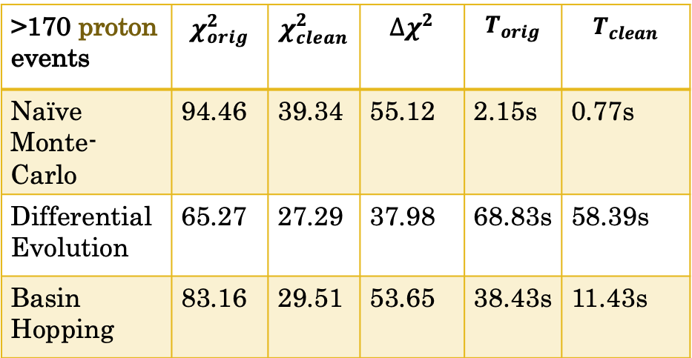
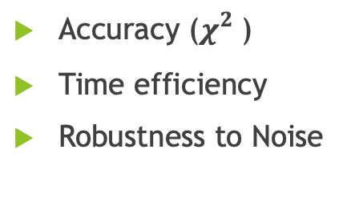
Results
>170 proton events | $$χ_{orig}^{2}$$ | $$χ_{clean}^{2}$$ | $$∆χ^{2}$$ | $$T_{orig}$$ | $$T_{clean}$$
Naïve Monte- Carlo | 94.46 | 39.34 | 55.12 | 2.15s | 0.77s
Differential Evolution | 65.27 | 27.29 | 37.98 | 68.83s | 58.39s
Basin Hopping | 83.16 | 29.51 | 53.65 | 38.43s | 11.43s
Accuracy ($χ_{}^{2}$)
Time efficiency
Robustness to Noise
Notes:
proton events only: we fitted the hand-labeled proton events, but ideally we use machine learning to classify proton events first
the lower the better!

Slide 18
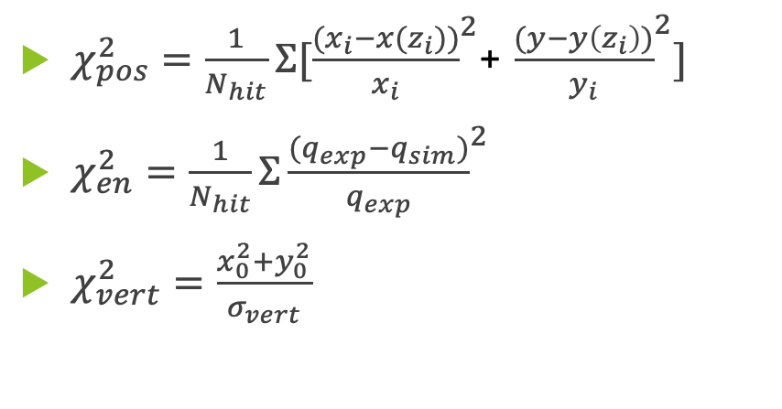
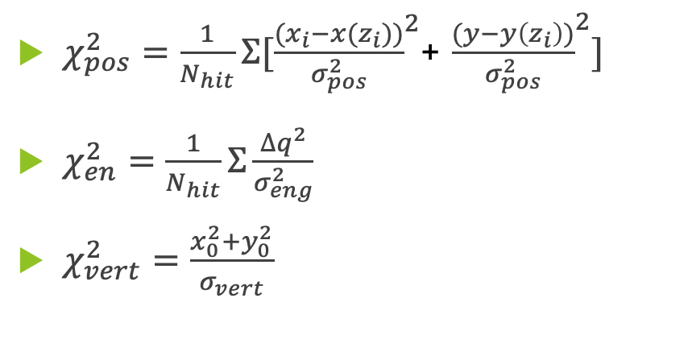

The Objective Function
${χ_{}^{2}=χ}_{pos}^{2}$+ $χ_{en}^{2}$+$χ_{vert}^{2}$
The original objective function
The modified objective function
$χ_{pos}^{2}=\frac{1}{N_{hit}}Σ[{\frac{{(x}_{i}−x(z_{i}))}{σ_{pos}^{2}}}^{2}$+ ${\frac{(y−y\left(z_{i}\right))}{σ_{pos}^{2}}}^{2}]$
$χ_{en}^{2}=\frac{1}{N_{hit}}Σ{\frac{∆q^{2}}{σ_{eng}^{2}}}^{}$
$χ_{vert}^{2}=\frac{x_{0}^{2}+y_{0}^{2}}{σ_{vert}}$
$χ_{pos}^{2}=\frac{1}{N_{hit}}Σ[{\frac{{(x}_{i}−x(z_{i}))}{x_{i}}}^{2}$+ ${\frac{(y−y\left(z_{i}\right))}{y_{i}}}^{2}]$
$χ_{en}^{2}=\frac{1}{N_{hit}}Σ{\frac{{{(q}_{exp}−q}_{sim})}{q_{exp}}}^{2}$
$χ_{vert}^{2}=\frac{x_{0}^{2}+y_{0}^{2}}{σ_{vert}}$
Unitless?
Comparable?
Weight too high on position?
Notes:
how accurate is the fitting for track position, energy, and vertex position.
the sigma here are arbitrarily defined; although it is unitless it doesn’t make sense to add them together

Slide 19
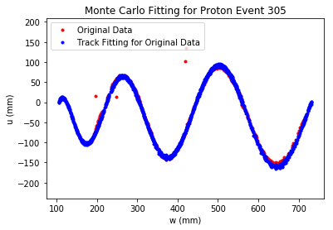
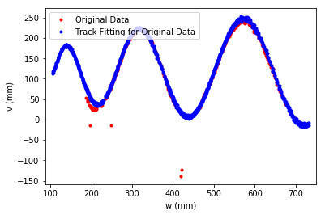
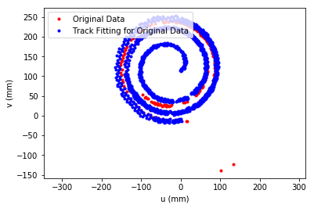
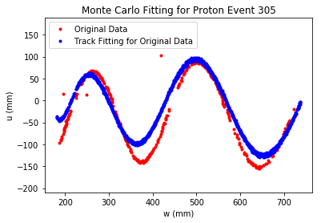
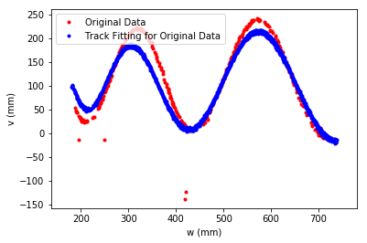
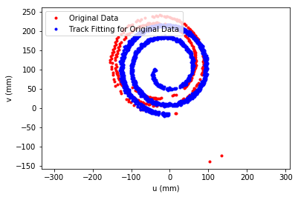
Results
Original objective function: $χ_{pos}^{2}$=21.15, $χ_{eng}^{2}$=7.92, $χ_{vert}^{2}$=3.06
New objective function*: $χ_{pos}^{2}$=21.28, $χ_{eng}^{2}$=20.30, $χ_{vert}^{2}$=0.74
*The chi-squared values are from different functions and therefore not directly comparable
Notes:
re-coded the MC algorithm on a single python file

Slide 20
Current and Future Work
Tuning functional parameters of differential evolution and basin hopping algorithms
Testing the new objective function using other global optimization methods
Training and testing machine learning models for track classification
Notes:
This is the step before fitting; allows us to only test fitting on proton events to determine best method

Slide 21

Acknowledgements
Dr. Michelle Kuchera
National Superconducting Cyclotron Laboratory
AT-TPC group
https://github.com/ATTPC/pytpc

